Slide 1
SRI RAMAKRISHNA ENGINEERING COLLEGE
[Educational Service : SNR Sons Charitable Trust]
[Autonomous Institution, Accredited by NAAC with ‘A’ Grade]
[Approved by AICTE and Permanently Affiliated to Anna University, Chennai]
[ISO 9001-2015 Certified and all eligible programmes Accredited by NBA]
VATTAMALAIPALAYAM, N.G.G.O. COLONY POST, COIMBATORE – 641 022.
Department of Electronics and Communication Engineering
16EC258-MINIPROJECT II
No. of Credits : 2
MP-II

Slide 2
SRI RAMAKRISHNA ENGINEERING COLLEGE
Class / Section / Semester | : | III ECE / B / V
Batch | : | 2019-23
Project Review | : | Zeroth Review
Title of the project | : | Retail Demand Forecast
Date | : | 01.10.2021
Project Guide | : | Mr. T .RAJASEKAR, AP/ECE
Team Members | : | K Karthik (1902102) S J Nithin Soundar (1902132) R Rithick Roshan (1902156)
MP-II

Slide 3
CHALLENGE STATEMENT
To forecast the demand of retail products in stores.
To minimize the replenishment between warehouses and stores.
MP-II

Slide 4
CONCEPT AND
SCOPE OF SOLUTION
Planning to meet demand that’s lower than what actually needs to be met will leave you scrambling to catch up. Planning to meet demand that is higher than what actually materializes will result in overstaffing and excess inventory. This is bad for the customer and bad for the store’s operational metrics.
Demand forecasting in retail is the act of using data and insights to predict how much of a specific product or service customers will want to purchase during a defined time period. This method of predictive analytics helps retailers understand how much stock to have on hand at a given time.
It is based upon the real-time analysis of demand which was there in the past for that particular product or service in the market present today.
MP-II

Slide 5
LITERATURE SURVEY /
BACKGROUND STUDY
PAPER | APPROACH | REMARKS
1.Hashini Warnakulasooriya, Janangi Senarathna et al. “Supermarket Retail – Based Demand and Price Prediction of Vegetables”. 20th International Conference on Advances in ICT for Emerging Regions (ICTer) Year: 2020 | Conference Paper | Publisher: IEEE | ARIMA- “autoregressive integrated moving average.” | This paper uses a vegetable tracking mechanism to improve transparency within the vegetable supply chain. This paper has forecasted the future price and demand of retail vegetables.
MP-II

Slide 6
LITERATURE SURVEY /
BACKGROUND STUDY
PAPER | APPROACH | REMARKS
2. Keqiao Chen. “An Online Retail Prediction Model Based on AGA-LSTM Neural Network”. 2nd International Conference on Machine Learning, Big Data and Business Intelligence (MLBDBI)Year: 2020 | Conference Paper | Publisher: IEEE | LSTM neural network The adaptive genetic algorithm (AGA) | This paper proposes an online retail prediction model based on AGA-LSTM neural network.
MP-II

Slide 7
LITERATURE SURVEY /
BACKGROUND STUDY
PAPER | APPROACH | REMARKS
3. Shaz Hoda, Amitoj Singh et al. “Consumer Demand Modeling During COVID-19 Pandemic”. IEEE International Conference on Bioinformatics and Biomedicine (BIBM) Year: 2020 | Conference Paper | Publisher: IEEE | Deep Learning based LSTM method. SARIMAX models -Seasonal Auto Regressive Integrated Moving Averages with Exogenous regressors. | The paper uses panel regression to understand the drivers of demand during the pandemic.
MP-II

Slide 8
LITERATURE SURVEY /
BACKGROUND STUDY
PAPER | APPROACH | REMARKS
4. Fatima Zohra Benhamida, Ouahiba Kaddouri et al. “Stock&Buy: A New Demand Forecasting Tool For Inventory Control”. 5th International Conference on Smart and Sustainable Technologies (SpliTech) Year: 2020 | Conference Paper | Publisher: IEEE | Clustering-based approach (ClustAvg). Comb-TSB . | A clustering-based approach (ClustAvg) is proposed to forecast demand for new products which have very few or no sales history data.
MP-II

Slide 9
EXISTING METHOD
The current methods of forecasting involves:
Conjoint Analysis
Conjoint analysis uses surveys to obtain consumer input about the most favorable attributes of their products. These surveys ask consumers how they would use and respond to certain product attributes.
Client Intent Surveys
With a buyer’s intentions survey, it asks what the consumer is planning on purchasing in the future. This technique is used to understand what motivates the customer to actually buy a product they are interested in.
Delphi Method
The Delphi method was developed with the assumption that forecasts from a group are generally more accurate than forecasts from individuals. As such, this method uses a panel of experts that provide their forecasts and justifications anonymously.
MP-II

Slide 10
PROPOSED METHOD
AND IMPLEMENTATION
The proposed method involves in the employment of predictive analysis.
Predictive analysis goes further than traditional demand forecasting by evaluating the reason why people buy. The process uses mathematical principles to predict consumer behavior by using current and historic data.
This model proposes a CNN-LSTM algorithm that combines the advantages of both Convolutional Neural Networks and Long-Short Term Memory cells to predict the demand for retail products within a stipulated time window to determine the optimal stock to be maintained at a retail outlet.
Adding convolutional layers to capture local, temporal patterns on top of LSTM layers can be immensely helpful.
The accuracy of CNN-LSTM model is greatly enhanced than the traditional LSTM model.
The demand of retail products is predicted using historical data of that particular retail outlet.
MP-II

Slide 11
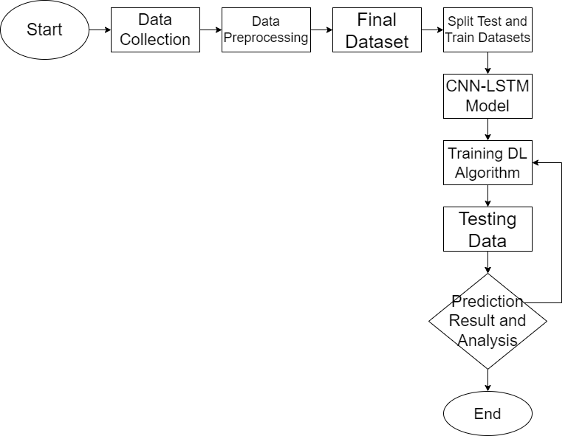
Block Diagram
MP-II

Slide 12
PROS AND CONS
OF THE SOLUTION
Advantages of forecasting
One can gain valuable insight
One can learn from past mistakes
It can decrease costs
Disadvantages of forecasting
It can be time-consuming and resource-intensive
MP-II

Slide 13
TECHNOLOGY USED
Software:
Python
Google Colab
Deep Learning(Time Series)
Multi Layer Perceptron Model
MP-II

Slide 14
THANK YOU

